Slide 1

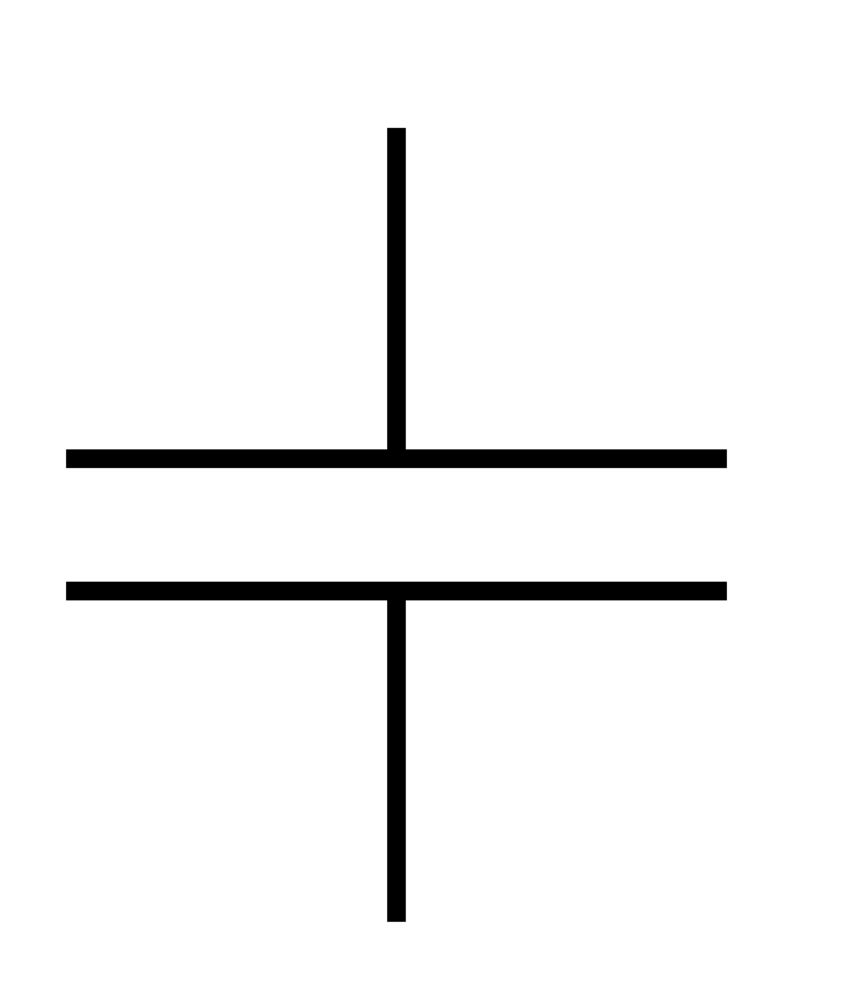









$$R_{1}= ?$$
$$+$$
$$−$$
$$V_{in}$$
$$C_{1}=220 nF$$
$$R_{f}=?$$
$$V_{out}$$
$$R_{g}=10 kΩ$$
GND
$$RC Stage$$
$$Gain Stage$$

Slide 2
$$R_{1}= ?$$
$$+$$
$$−$$
$$V_{in}$$
$$C_{1}=220 nF$$
$$R_{f}=?$$
$$V_{out}$$
$$R_{g}=10 kΩ$$

Slide 3
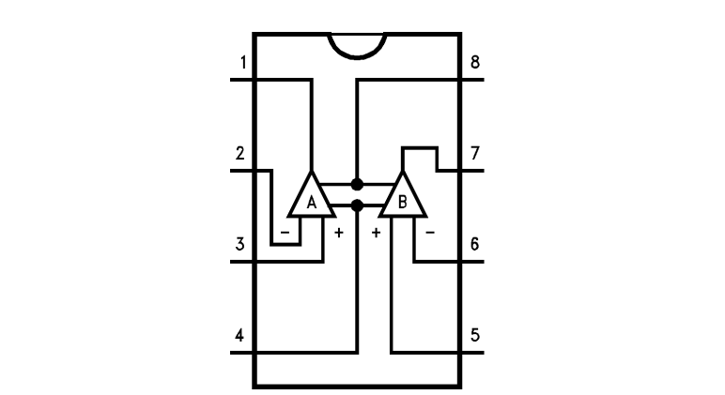





↓ Pin
1- Pin
1+ Pin
$$R_{g}=10 kΩ$$
$$R_{f}=?$$
V+ Pin
$$R_{1}= ?$$
W1 Pin
V- Pin
$$C_{1}=220 nF$$
$$MCP 6022 Op−Amp$$
↓ Pin

